Slide 1
Assessing the environmental impacts of different IPSS deployment scenarios for the light commercial vehicle (LCV) industry Dina ANDRIANKAJA Natacha GONDRAN Jesus GONZALEZ-FELIU
7th CIRP IPSS Conference, may 2015

Slide 2
Agenda
Context and objective
Scenarios assessment
Environmental assessment (LCA)
Results
Conclusion and perspectives

Slide 3
Context
Reduction of GHG emissions of transport
Sustainable urban goods transport
Green vehicles vs green organisation
PSS schemes: care-sharing, public-private partnerships …
Advantages of PSS: economics, environmental
Objective: environmental assessment of different IPSS scenarios for urban goods transport

Slide 4
Construction of scenarios / Hypotheses
Carrier behavior data
Only vehicles with 3.5t of full loaded weight
100 representative vehicle’s rounds for urban delivery (routes made with LCV)
Focus on third-party transport only

Slide 5
Construction of scenarios
Reference scenario (0): each company owns its LCV fleet
Scenario 1: Internal reorganization
Leasing system + routes’ optimization (reduction of the number of LCV)
Scenario 2: Vehicle sharing system
Leasing system + logistics sharing system (vehicles are common to all users)
Scenario 3: Logistics pooling system
Vehicles + urban distribution center (UDC)

Slide 6
Reference scenario (S0)
123 routes → 31 carries
Carriers’ platforms location: inside a 14km x 14 km zone in the Eastern part of a city
Each route respect French legislation (driving time)
One vehicle = one driver, but multiple routes

Slide 7
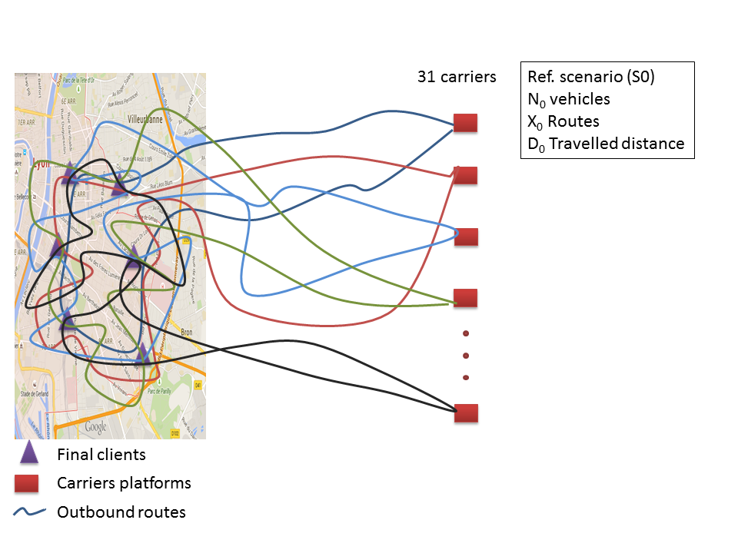
Scenarios

Slide 8
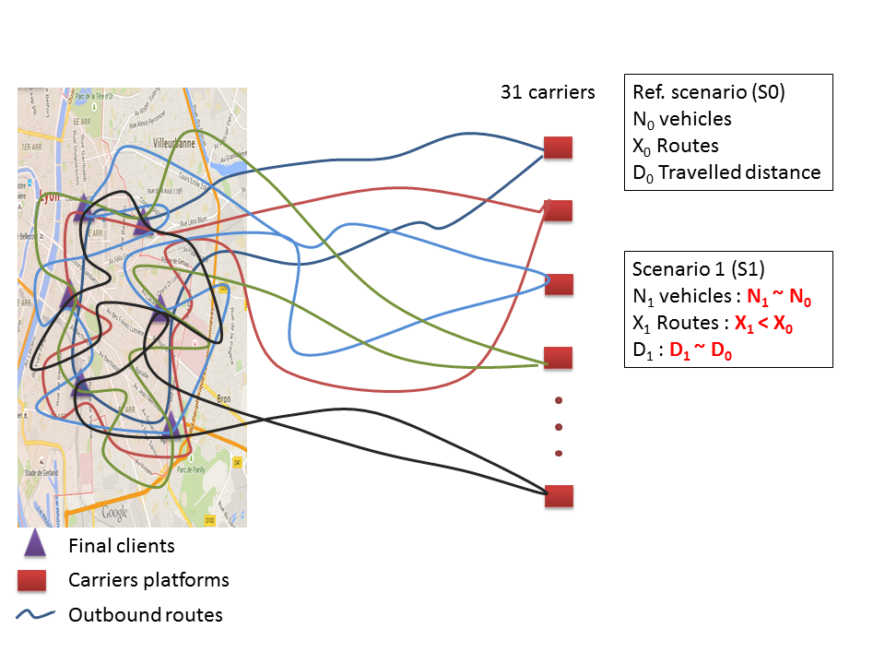
Scenarios

Slide 9
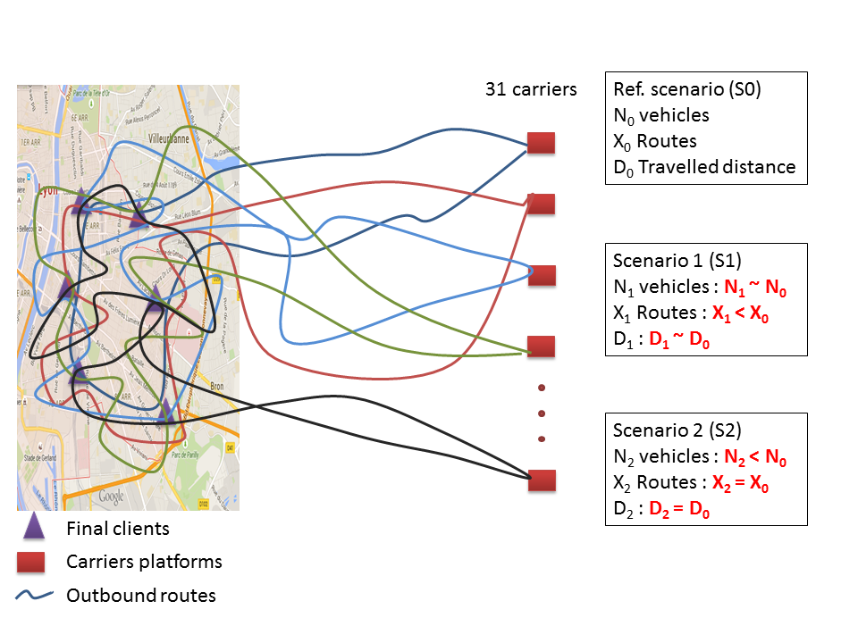
Scenarios

Slide 10
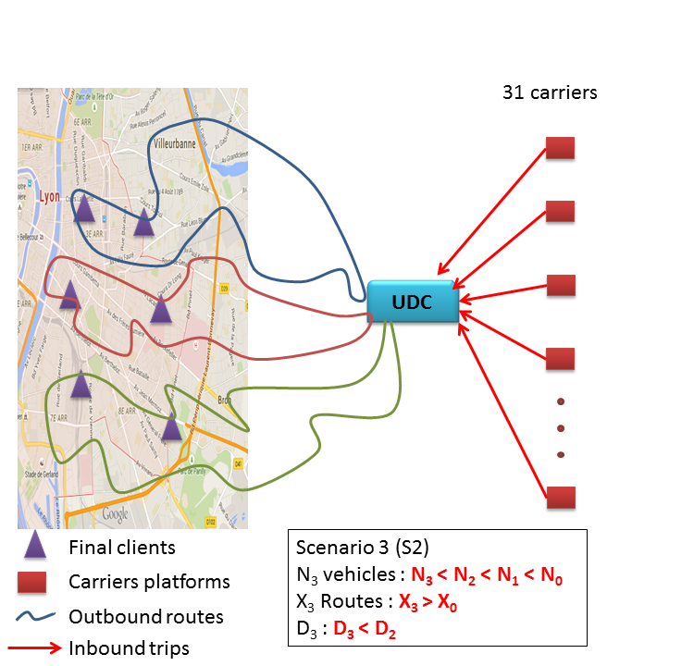
Scenarios

Slide 11
Scenarios
 | S0 | S1 | S2 | S3
Number of vehicles | 100 | 96 | 85 | 56
Number of routes | 123 | 96 | 123 | 187
Total daily distance (km) | 5513 | 5355 | 5513 | 3610

Slide 12
Environmental assessment: LCA
Impacts of all different stages of the LCV’ s life (production, operation, maintenance, disposal)
Direct impacts and Indirect impacts
Method based on the standardized LCA methodology (ISO 14040)
Functional unit: to deliver 70t of goods from 31 carriers to the urban center in one day
Impact method: ReciPe
Nine impact categories considered
Data used : ecoinvent database v2.1 (2010)

Slide 13
Impact categories considered
Impact categories | Units | Substances
Global warming potential | kg CO2 eq | All greenhouse gases
Terrestrial acidification potential | kg SO2 eq | NH3, SO2, NOx
Photochemical oxidant formation | kg NMVOC eq | Non-methane volatile organic compounds
Particulate matter formation | kg PM10 eq | PM, SO2, NOx, NH3
Fossil depletion | kg oil eq | Coal, gas, oil
Metal depletion | kg Fe eq | All metals
Urban land occupation | m²*a
Fossil energy | MJ eq | Coal, gas, oil, peat, uranium, primary forest
Renewable energy | MJ eq | Hydro, wind, geo, solar, biomass energies

Slide 14
Main results
 | Reduction of impacts Gap to the reference scenario (S0)
Scenarios | Direct impacts | Indirect impacts
S0: traditional transport organization | - | -
S1: internal reorganization | 3 % | 4 %
S2: vehicle sharing system | 0 % | 15 %
S3: logistics pooling system (UDC) | 35 % | 44 %

Slide 15
Conclusion and perspectives
IPSS configurations → reduction of the number of vehicles / reduction of the kilometres travelled
Then environmental gains
The best IPSS configuration is UDC but its implementation requires several conditions
S1, S2 can give best environmental impacts if we considered “green vehicles”
Method sensible to the functional unit
→ transferable when the same functional unit is used

Slide 16
Thank you for your attention!
dina.andriankaja@emse.fr
Ecole des Mines de Saint-Etienne / PIESO
Une école de l'Institut Mines-Télécom

